Slide 1
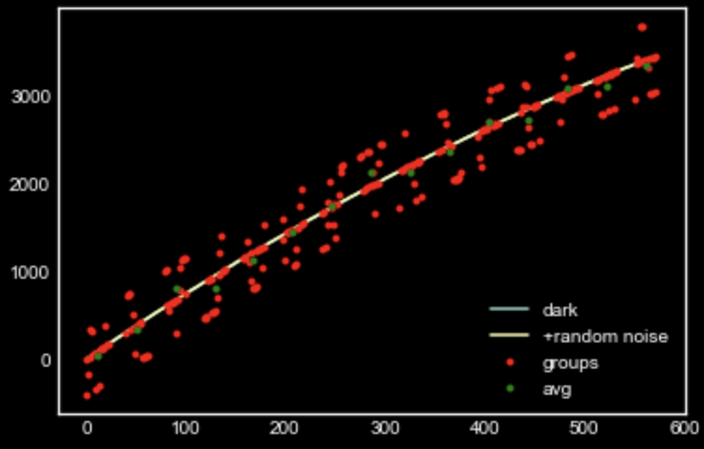
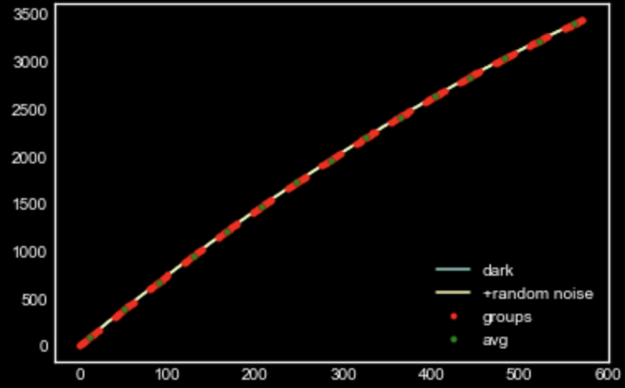
sample MAAC simulator with and without RTN Light current = 10.0, Dark current = 0.04, read noise = 9.0 and (ng=15, nf=16, nd=11)

Slide 2
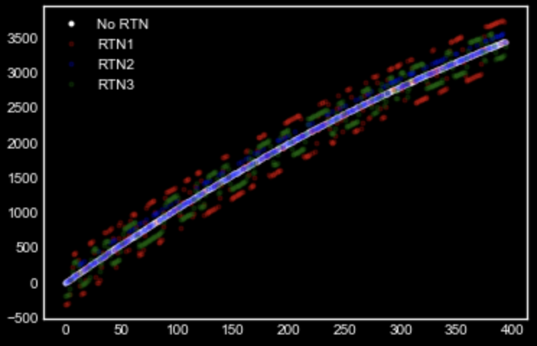
RTN2 always above. Right?

Slide 3
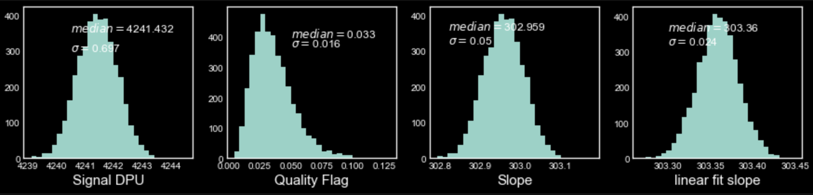
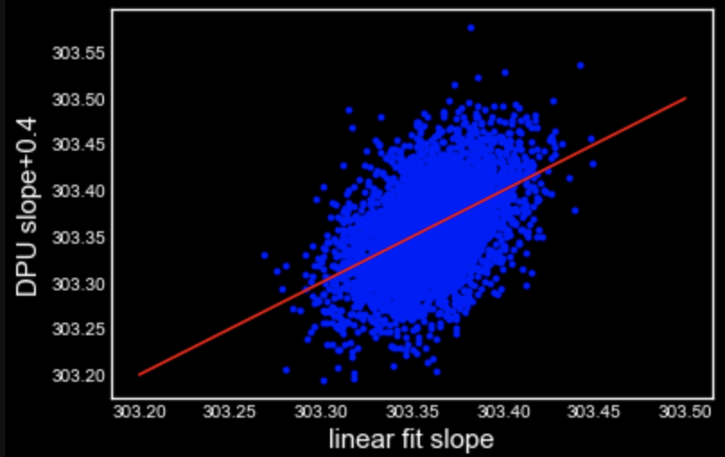
With NO NL and RTN change in the QF, DPU signal, slope and Linear slope

Slide 4
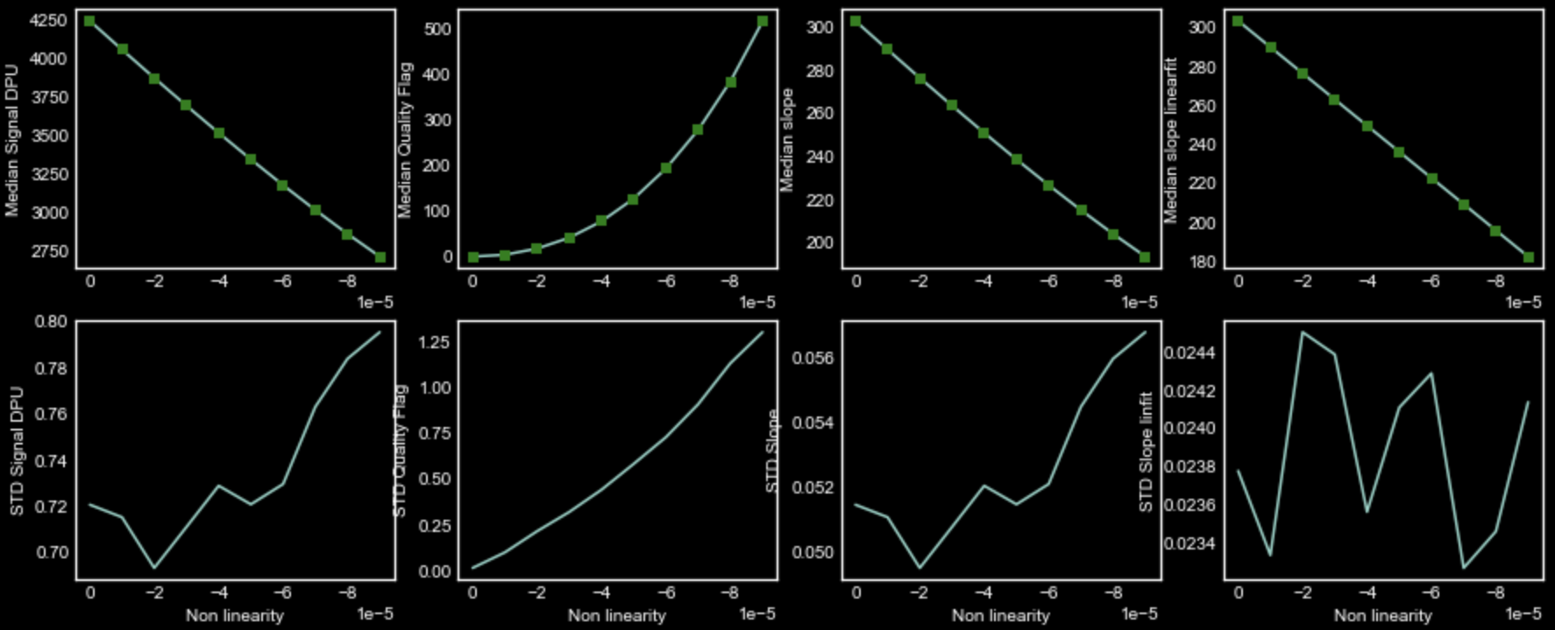
Change in signal and QF with Varying NL (no RTN)

Slide 5
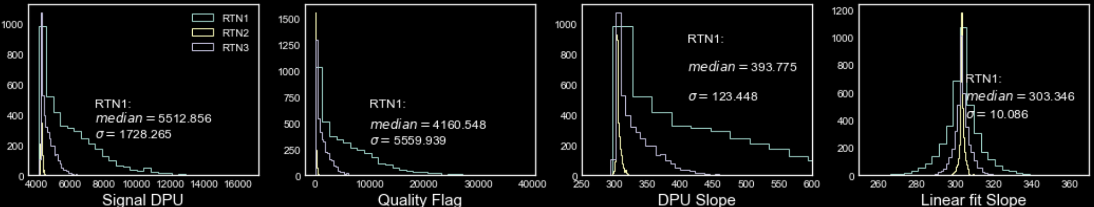
Change in Slope/signal and QF with RTN (no NL)
RTN rate and nelements are fixed here to 0.2 and 2000 respectively

Slide 6
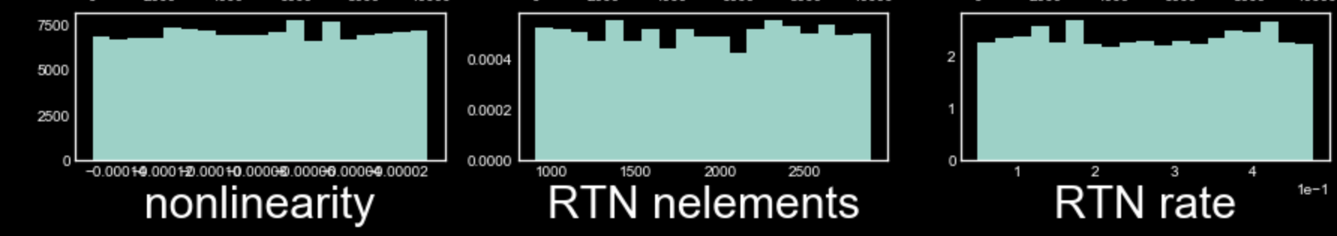
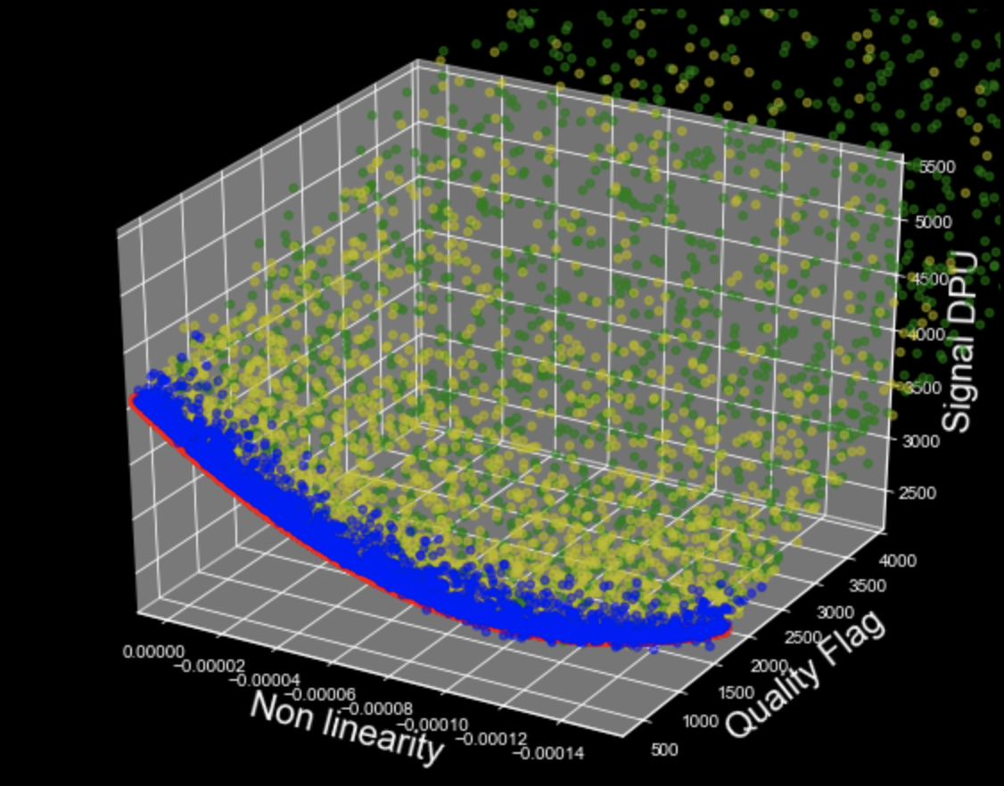
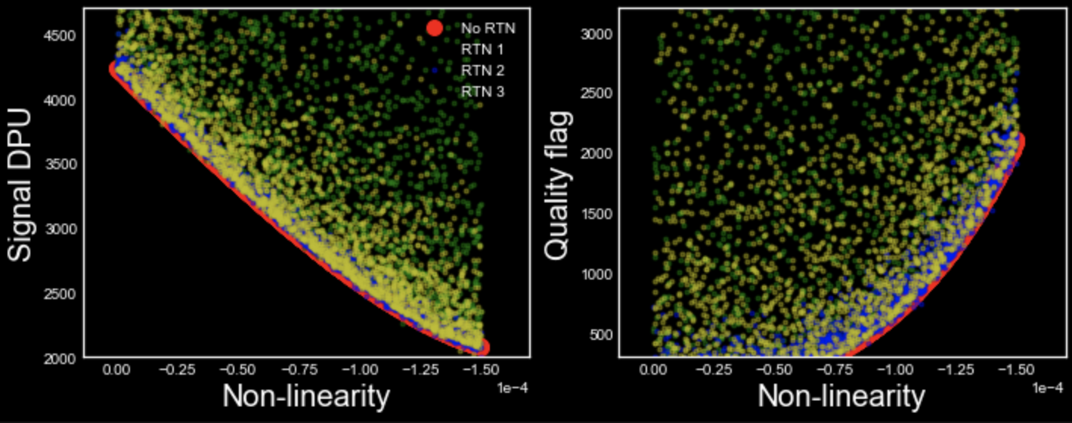
MCMC with 3 kinds of RTN and varying NL

Slide 7
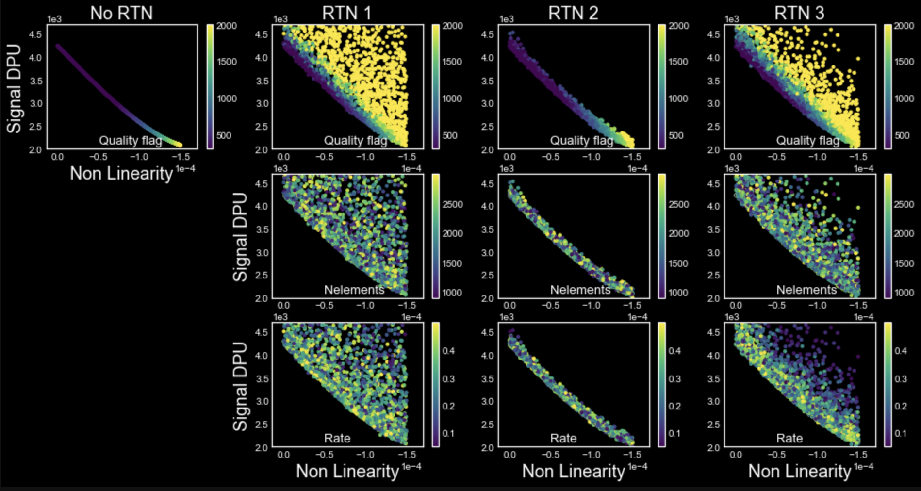

Slide 8
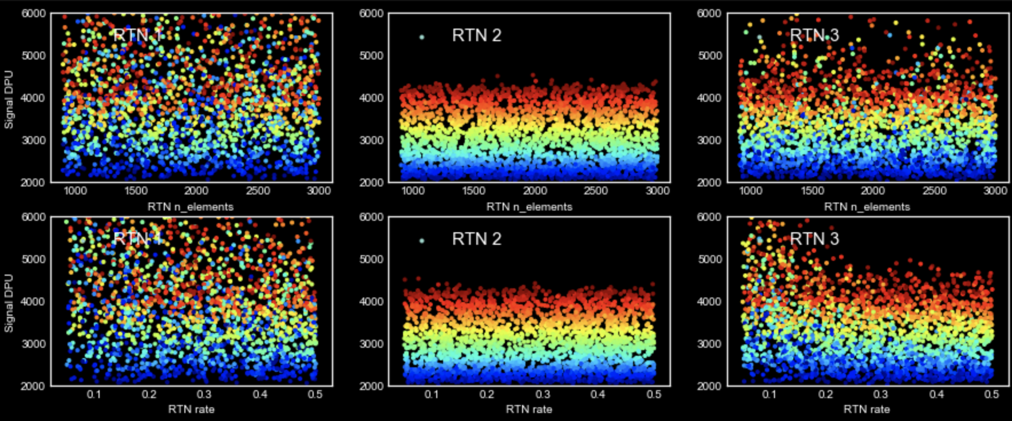
Almost no dependence of Signal on nelements and rate of RTN

Slide 9
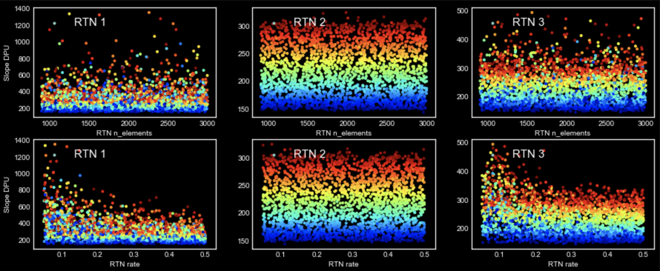
Some dependence of DPU Slope on nelements and rate of RTN

Slide 10
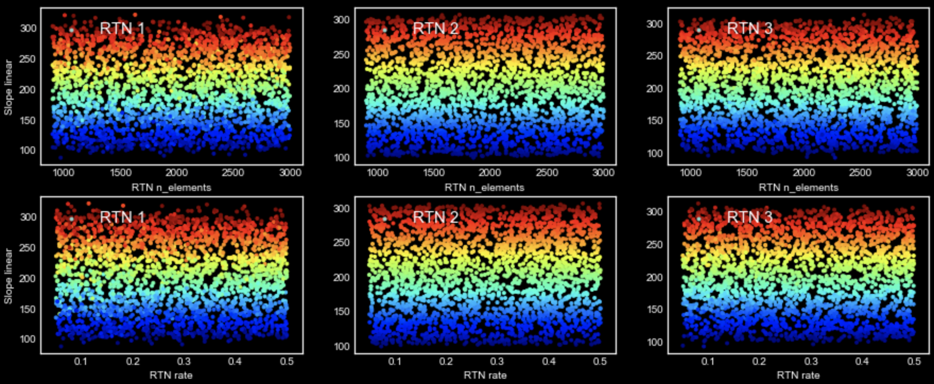
No dependence of Linear Slope on nelements and rate of RTN

Slide 11
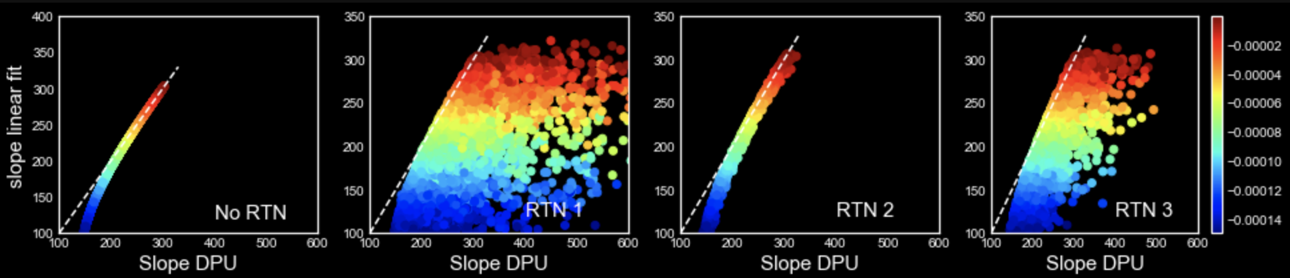
Linear slope vs. DPU slope different RTNs Color coded by NL

Slide 12
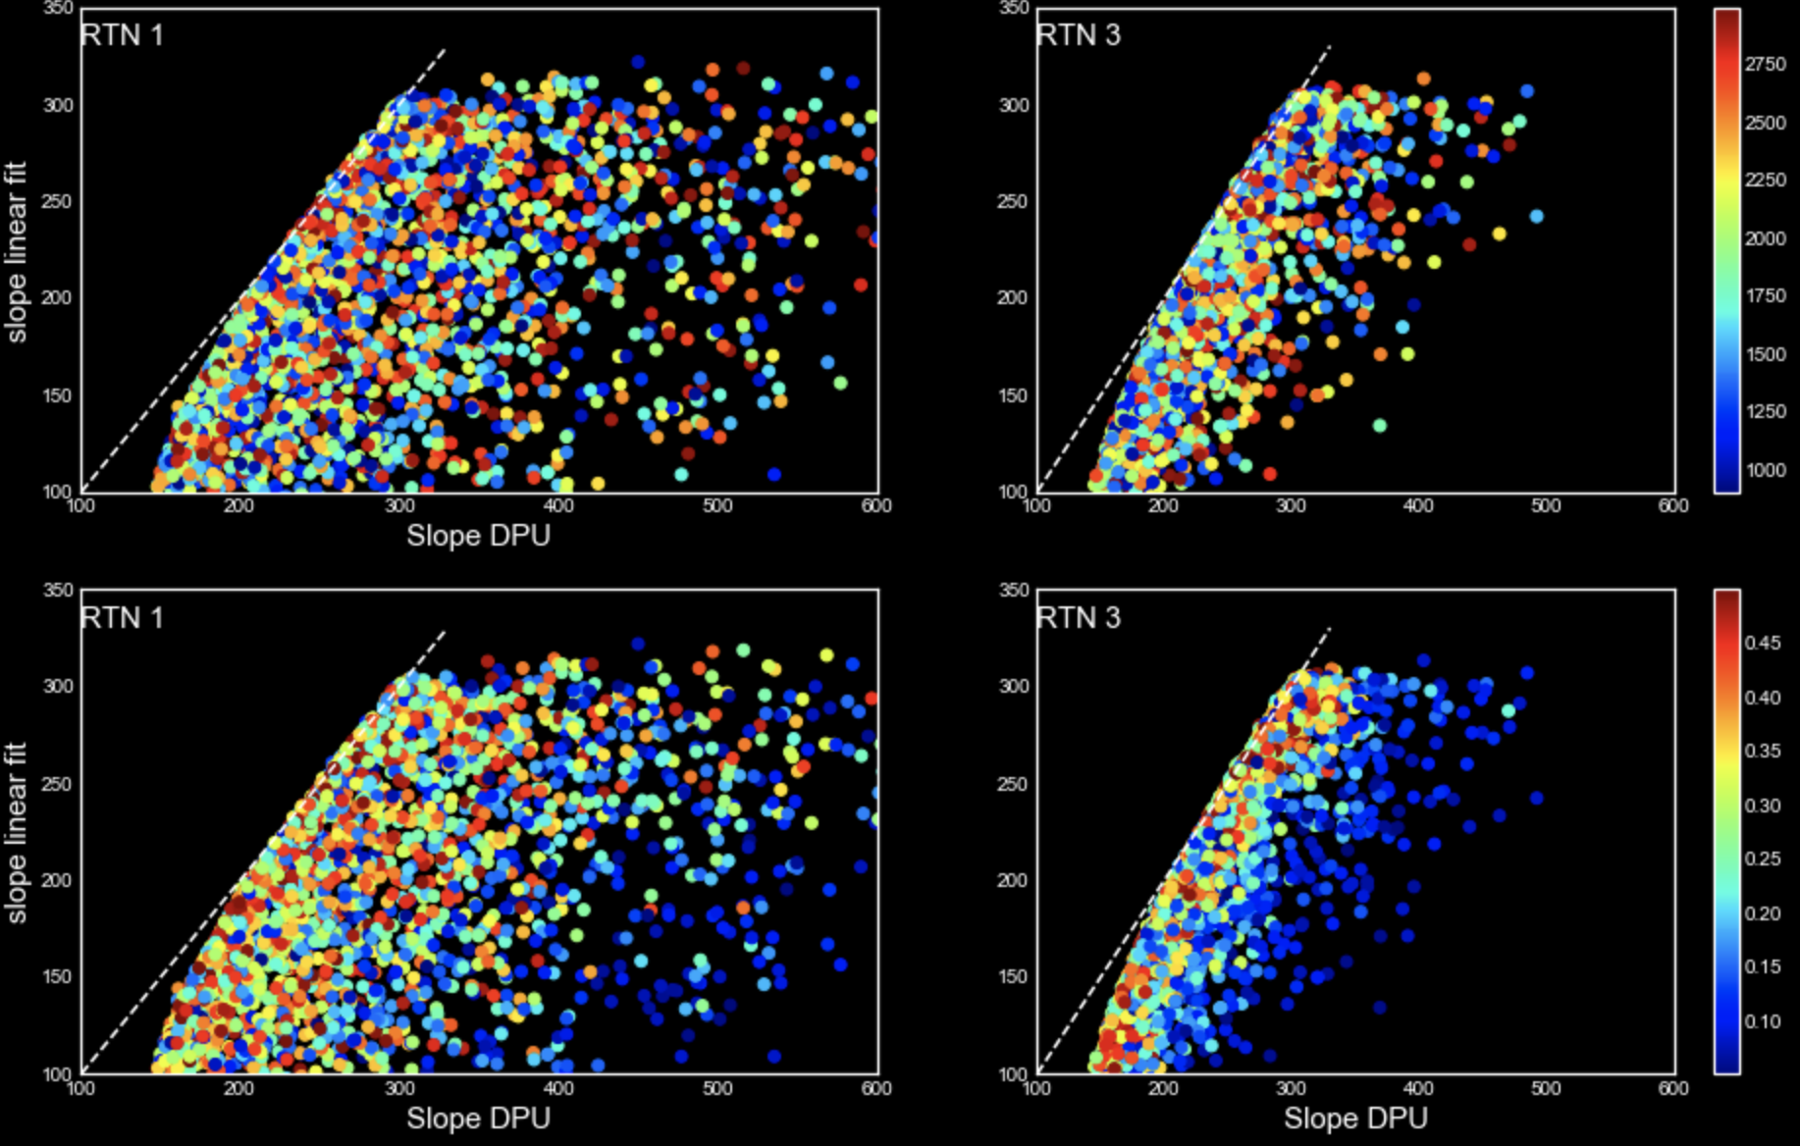
RTN 1 &3 color-coded by nelements(top) and rate (bottom)

Slide 13
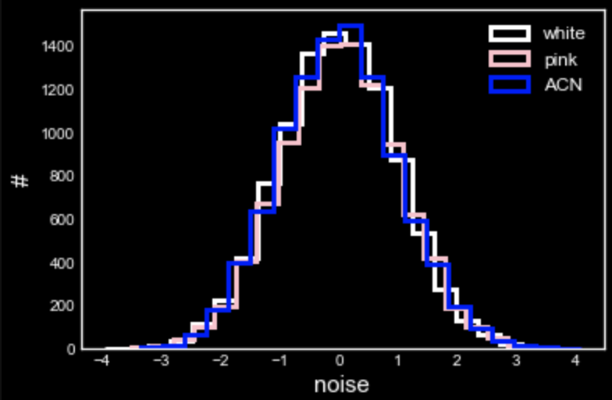
Bringing in more noise from noise generator package.
Many names but distributions are almost the same!
Maybe difference is only in the way they are added to images?
If that’s the case then adding these noise in pixel level rather than image might not be optimal?!
How can spatial correlations be taken into account at pixel level?

